Slide 1
Computer Ergonomics
Bob Marshall, MD MPH MISM FAAFP DoD/MAMC Clinical Informatics Fellowship

Slide 2
What are Computer Ergonomics?
Ergonomics: science of designing a job, equipment and/or workplace to fit the worker.
Goal: optimize "fit" between worker and his or her work environment to optimize performance and reduce risk of repetitive strain injuries.
Computer ergonomics: addresses ways to optimize computer workstation to reduce specific risks of computer vision syndrome (CVS), neck and back pain, carpal tunnel syndrome and other disorders affecting muscles, spine and joints.

Slide 3
Why are ergonomics important?
Prolonged and repetitive work at a computer workstation can create discomfort, muscle aches, and be the cause of work-related injuries
Improper posture and improper body positioning at a computer workstation can cause or exaggerate the problems
There is risk for headaches, burning eyes, red eyes, a stiff neck and other symptoms that comprise computer visual syndrome (CVS)
Prolonged computer work also can cause physical stress that eventually could lead to disability

Slide 4
Why Computer Ergonomics?
Many people spend hours a day in front of a computer without thinking about the impact on their bodies
They physically stress their bodies daily without realizing it by extending their wrists, slouching, sitting without foot support and straining to look at poorly placed monitors
These practices can lead to cumulative trauma disorders or repetitive stress injuries, which create a life-long impact on health.
Symptoms may include pain, muscle fatigue, loss of sensation, tingling and reduced performance.

Slide 5
Workplace Ergonomics and MSK Disorders
According to Hugesoccupational.com, The Occupational Safety and Health Administration (OSHA) has identified that Work-Related Musculoskeletal Disorders (WMSDs) are the single largest job-related injury and illness problems in the USA.
Work Related Musculoskeletal Disorders account for 34% of all reported illnesses and injuries, totalling 626,000 days away from work.
Carpal Tunnel Disorders are the single most common injury in the workplace

Slide 6
Ergonomics and the Bottom Line
The lack of Ergonomics in the workplace leads to these costs:
How much you spend on your employees' long-term health and safety
How much you spend on boosting employees' and company morale
Turnover
Absenteeism
Productivity
Product quality (how much do mistakes cost?)
Lawsuits
Compensation claims?

Slide 7
Principles of computer ergonomics - 1
Use a good chair with a dynamic chair back that is angled slightly to the rear.
Top of monitor screen should be 2-3" above eye level
No glare on screen; use an optical glass anti-glare filter where needed
Sit at arms length from monitor; further if distance is comfortable and screen's readable.
Rest feet on floor or on a stable foot rest (move feet frequently for circulation)
Use a document holder, preferably in-line with the computer screen

Slide 8
Principles of computer ergonomics - 2
Wrists flat and straight in relation to forearms to use keyboard/mouse/input device (which are located within easy reach)
Keeps arms and elbows relaxed close to body
Center monitor and keyboard in front of you
Use a neutral or negative tilt keyboard tray with an upper mouse platform or downward tilt-able/neutral platform adjacent to keyboard
Use a stable work surface and stable (no bounce) keyboard tray
Take frequent short breaks (micro breaks) and stretch

Slide 10

Additional Advice

Slide 11
Modify Body Mechanics
Do you wear eyeglasses?
Make sure they fit properly to avoid tilting your head
Type with light strokes and try to keep your muscles relaxed
Sit "tall," aligning your ears, shoulders and hips. When you sit, think about making yourself an inch taller
Switch hands when using a mouse, if you are able
Completely rest your wrists during breaks, including taking your hands off the mouse

Slide 12
Adjust Work Patterns
Reduce prolonged computer time whenever possible
Break work into smaller segments and switch between tasks that use different motions
For example, alternate use of mouse with reading and searching the web

Slide 13
Move!
Movement has many benefits: it relaxes tissues, lubricates joints and prevents stiffness, improves circulation, reduces fatigue, and builds stamina
One study showed that heavy computer users who avoided computer-related pain moved every 7 minutes
At least every 10 minutes, take a short (10-20 second) break
Take your hands off the keyboard and move!
Every 30-60 minutes, take a brief (2-5 minute) break to stretch and/or walk around

Slide 14
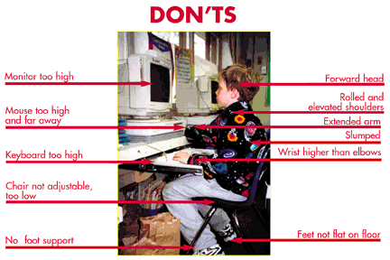
What you should not do

Slide 15
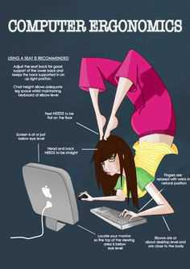
Yeah, maybe not!

Slide 16
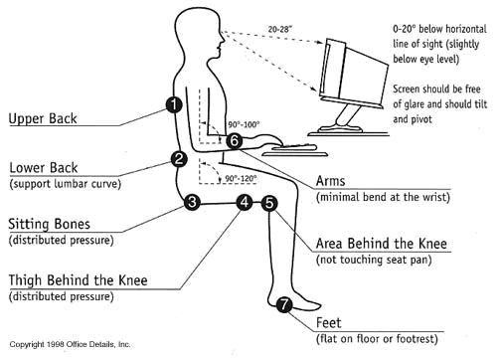
What you should do

Slide 17
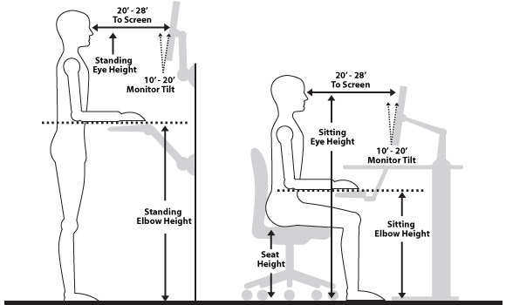
Some visuals about ergonomics

Slide 18
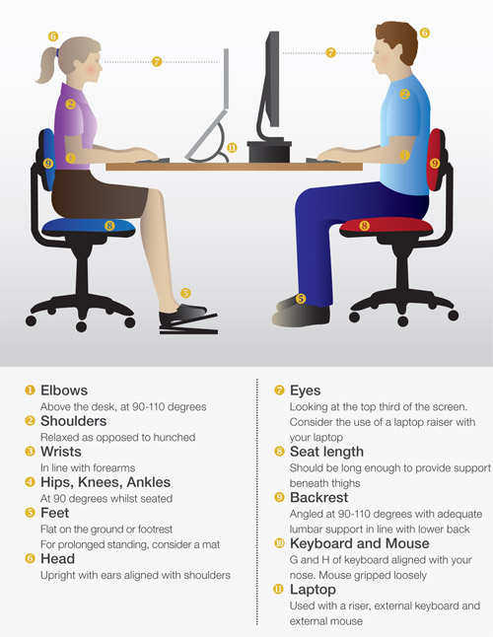
Laptop versus desktop setup

Slide 19
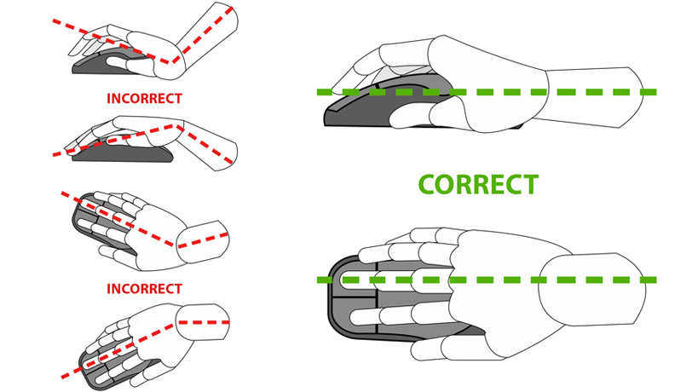
Mouse ergonomics

Slide 20
The take home
Computer ergonomics is an important topic
Like hypertension, managed poorly, you may not feel bad right away…but eventually you will pay a price, maybe a significant one
Pay attention to the small things about equipment placement, posture, taking breaks
Ergonomics are important whether sitting or standing, whether desktop or laptop (or tablet)
Ergonomics are investments in yourself and your people; it costs more to not make the investment
Lots of resources exist to help do it right

Slide 21

questions

Slide 22
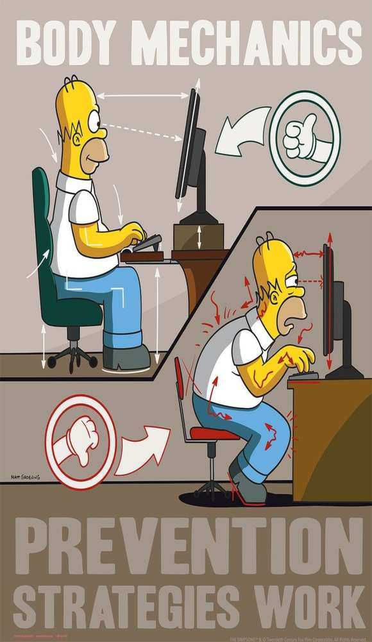
Backup Slides

Slide 23
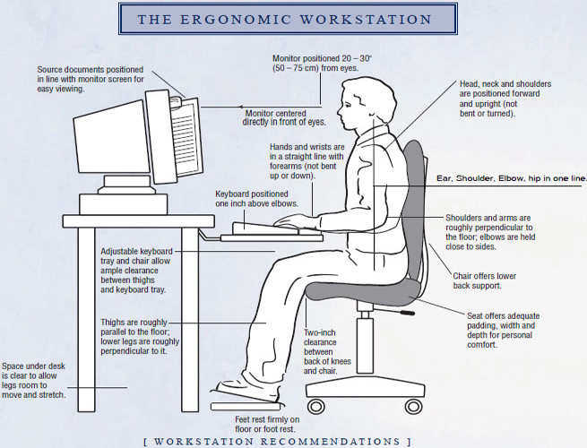

Slide 24
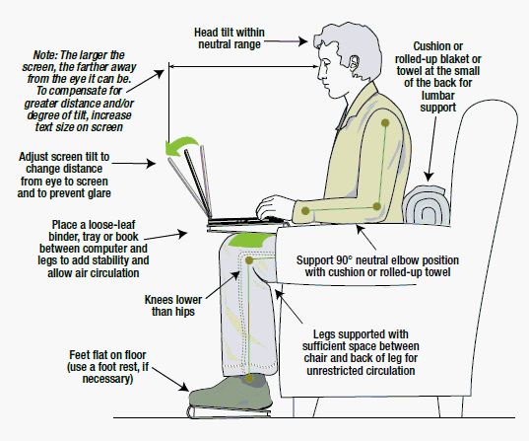

Slide 25
